Slide 1

TRACKR
JD Railsback

Slide 2
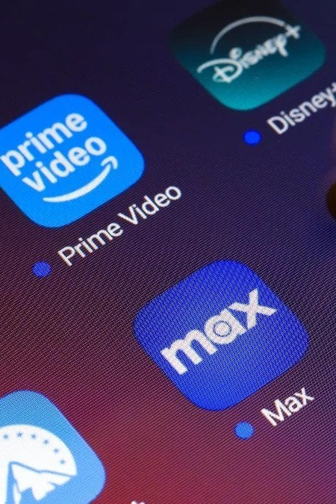
Streaming Fatigue
110 Hours
average time spent annually scrolling through streaming sites deciding what to watch
80 Platforms
streaming services operating in the US as of 2026
26 New Films
14 TV Episodes
38 Video Games
average releases per day

Slide 3



Existing Solutions
Video Games
Movies
TV Shows
Notes:
These are primarily social platforms focused on one specific niche. None can simply and effectively track upcoming and past releases across their individual media types.

Slide 4
Multifunctional tracking platform for staying up to date with releases across different media types.
TRACKR

Slide 5
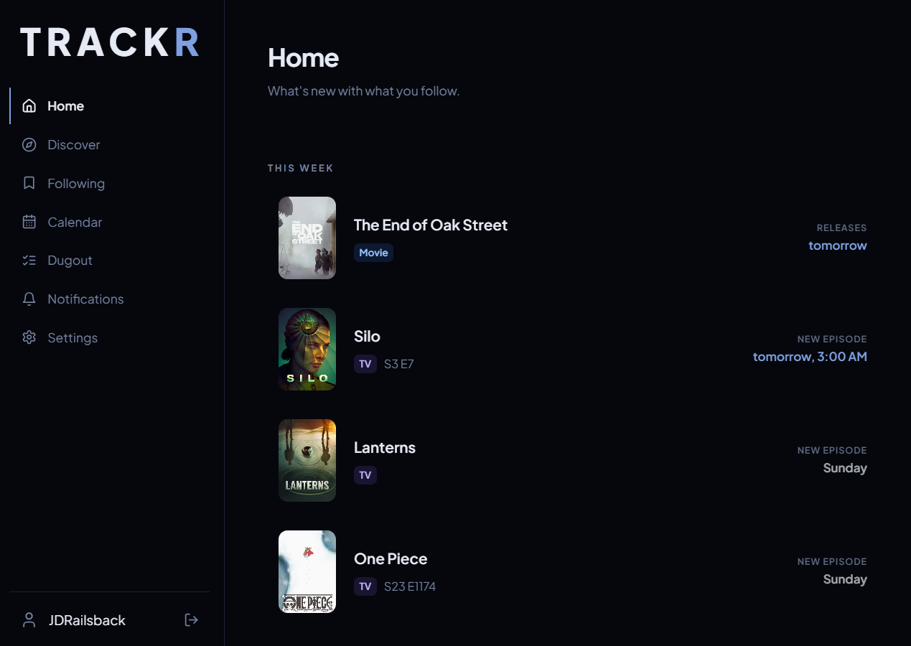
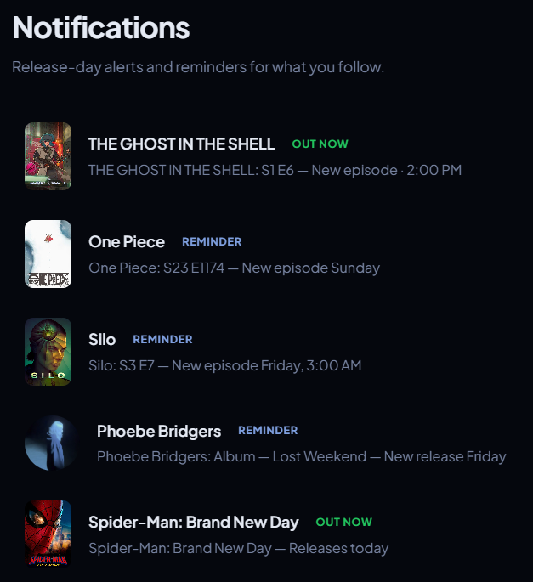

Slide 6
Compliment, not Competition
Trackr
Letterboxd and Others
Tracking what you want to watch next
Multiple media types
Notifications for new releases
Can be used alongside other social platforms
Tracking what you’ve already watched
Focus on one media type
No way to track new releases
Media tracking as a social media

Slide 7
Primary Features
FOLLOW ANYTHING: choose your favorite tv shows, movies, video games, and more and keep up to date with all new releases with ease
DISCOVER MORE: explore to see what’s new, or something you may have missed from years ago
FORM YOUR DUGOUT: add any items to your watchlist and line up what you looking to do next

Slide 8
Business Model
Free Tier
Paid Tier
$0/year
$10/year
Access to basic tracking features
Full discover page access to track any media items
Ability to view calendar page on site
Access to all features
Customizable notifications for any media items
Ability to sync calendar with other apps like Apple, Google, Outlook, etc.
Access to the “Dugout” page
Profile customization

Slide 9



Marketing
Friends & Family
Online Forums
Word-of-Mouth

Slide 10
Roadmap
Finalize release date pipeline
App Store launch
Initial paid tier at $5/lifetime for early users
Short-term
Implement personalized recommendations
Expand media types (books, live events, etc.)
Strengthen infrastructure for larger userbase
Mid-term
Seek out direct data partnerships
Embeddable release-calendar widget
Explore affiliate revenue for storefront links
Long-term

Slide 11
Sources
Streaming Media Survey: Viewers Can't Find What To Watch
Streaming Fatigue Report 2026: How Price Hikes Are Changing the Way Americans Watch TV | Reviews.org
Lights, Camera, Action— How Many Movies Are Released Daily Around the World? - System Ent Corp
How Many Video Games Exist in Total? – WorthyGamer
Media Entertainment Industry Statistics 2026
How Many Streaming Services Are There? Here's a List | Streaming Better

